Slide 1
-:WBC Multiclass Classification :- -: Project Finale :-
Done and Submitted by :
Girish Tripathy
Shashank Saumya
Instructor:
Dr. Subhankar Mishra

Slide 2
What we had achieved
We had a simple working CNN model.
The model was overfitting.
Training after data augmentation was not possible on our devices.

Slide 3
What we did
Shifted to Google Co-lab
Data Augmentation
Image Segmentation
Trying Different models and hyperparameters

Slide 4
Data Augmentation

Slide 5
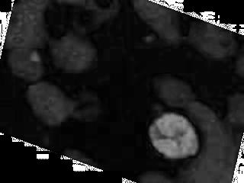

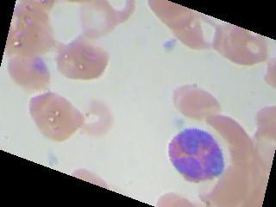
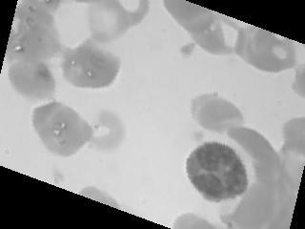
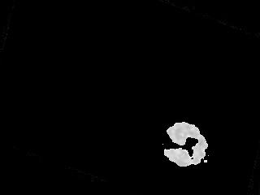
Nucleus Segmentation
HSV
Saturation
Otsu
Threshold
RGB Image
Grayscale
Combined Image

Slide 6
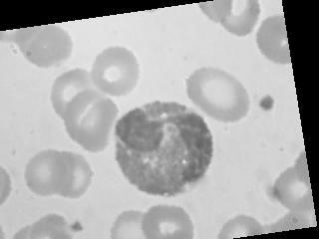
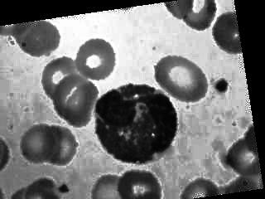
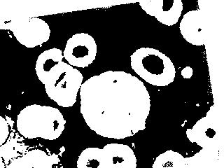
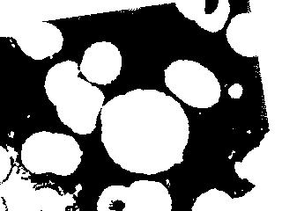
Cell Segmentation
Original
AHE
Otsu Threshold
Erosion

Slide 7
Image Segmentation
Not the best technique out there.
Works well for the colour scheme in our dataset.
There are some images which do not work well with my nucleus segmentation technique.
Unable to completely remove all other cell holes in cell segmentation

Slide 8
Trying different models and their results

Slide 9
Problems we see and possible fixes

Slide 10
Our 5 Mins…

Slide 11
References
Information on NN:-
Basic NN:- Course on coursera by Andrew Ng
CNN:- Ming Li (MIT, waterloo) lectures on Deep Learning and google
Research Papers:-
M. Sharma, A. Bhave, R.R. Janghel, White Blood Classification using Convoluted Neural Networks, Springer 2019
S. Manik, L.M. Saini, N.Vadera, Counting and classification of white blood cell using Artificial Neural Network (ANN), in IEEE International Conference on Power Electronics, Intelligent Control and Energy Systems (ICPEICES), IEEE (2016)

Slide 12
Thank You

